Slide 1
Data Structures and Algorithms
IT12112
www.hndit.com
By
Wathsala Samarasekara
M.Sc. , B.Sc.

Slide 2
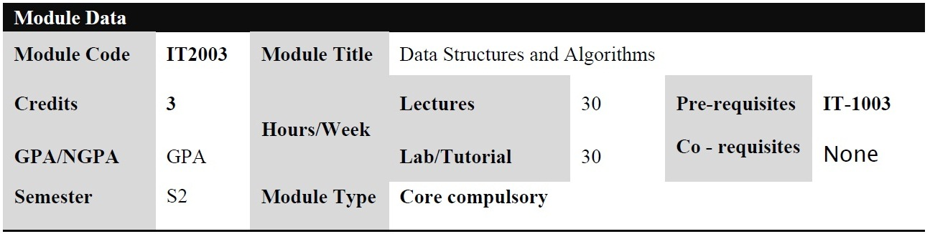
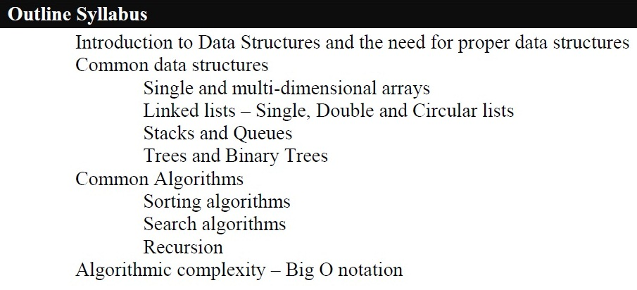
www.hndit.com

Slide 3
Organizing Data
www.hndit.com
Any organization for a collection of records can be searched, processed in any order, or modified.
The choice of data structure and algorithm can make the difference between a program running in a few seconds or many days.
Notes:
If you are willing to pay enough in time delay. Example: Simple unordered array of records.

Slide 4
What is a Data Structure ?
www.hndit.com
Definition :
An organization and representation of data
  representation
    data can be stored variously according to their type
      signed, unsigned, etc.
    example : integer representation in memory
  organization
    the way of storing data changes according to the organization
      ordered, inordered, tree
    example : if you have more than one integer ?

Slide 5
Data Structure (cont.)
www.hndit.com
A data structure is an arrangement of data in a computer's memory or even disk storage.
A data structure is the physical implementation of an ADT.
  Each operation associated with the ADT is implemented by one or more subroutines in the implementation.
Data structure usually refers to an organization for data in main memory.
Common data structures include:
array, linked list, hash-table, heap, Tree (Binary Tree, B-tree,etc.), stack, and queue.

Slide 6
The Need for Data Structures
www.hndit.com
Data structures organize data
⇒ more efficient programs.
More powerful computers ⇒ more complex applications.
More complex applications demand more calculations.
Notes:
A primary concern for this course is efficiency.
You might believe that faster computers make it unnecessary to be concerned with efficiency. However…
So we need special training.

Slide 7
Efficiency
www.hndit.com
A solution is said to be efficient if it solves the problem within its resource constraints.
  Space
  Time
The cost of a solution is the amount of resources that the solution consumes.
Notes:
Alternate definition: Better than known alternatives (“relatively efficient”).
Space and time are typical constraints for programs.
This does not mean always strive for the most efficient program. If the program operates well within resource constraints, there is no benefit to making it faster or smaller.

Slide 8
Selecting a Data Structure
www.hndit.com
Select a data structure as follows:
Analyze the problem to determine the resource constraints a solution must meet.
Determine the basic operations that must be supported. Quantify the resource constraints for each operation.
Select the data structure that best meets these requirements.
Notes:
Typically want the “simplest” data structure that will meet the requirements.

Slide 9
Some Questions to Ask
www.hndit.com
Are all data inserted into the data structure at the beginning, or are insertions interspersed with other operations?
Can data be deleted?
Are all data processed in some well-defined order, or is random access allowed?
Notes:
These questions often help to narrow the possibilities.
If data can be deleted, a more complex representation is typically required.

Slide 10
Data Structure Philosophy
www.hndit.com
Each data structure has costs and benefits.
Rarely is one data structure better than another in all situations.
A data structure requires:
  space for each data item it stores,
  time to perform each basic operation,
  programming effort.
Notes:
The space required includes data and overhead.
Some data structures/algorithms are more complicated than others.

Slide 11
Properties of a Data Structure ?
www.hndit.com
Efficient utilization of medium
Efficient algorithms for
  creation
  manipulation (insertion/deletion)
  data retrieval (Find)
A well-designed data structure allows using little
  resources
  execution time
  memory space

Slide 12
Basic Data Structures
www.hndit.com
Scalar Data Structure
– Integer, Character, Boolean, Float, Double,
etc.
Vector or Linear Data Structure
– Array, List, Queue, Stack, Priority Queue, Set,
etc.
Non-linear Data Structure
– Tree, Table, Graph, Hash Table, etc.

Slide 13
Scalar Data Structure
www.hndit.com
A scalar is the simplest kind of data that C++
programming language manipulates.
A scalar is either a number (like 4 or 3.25e20) or a character.
(Integer, Character, Boolean, Float,Double, etc.)
A scalar value can be acted upon with operators
(like plus or concatenate), generally yielding a
scalar result.
A scalar value can be stored into a scalar variable.
Scalars can be read from files and devices and written out as well.

Slide 14
Linear Data Structure
www.hndit.com
Linear data structures organize their data elements in a linear fashion, where data elements are attached one after the other.
Linear data structures are very easy to implement, since the memory of the computer is also organized in a linear fashion.
E.g. Array, Linked List, Stack, Queue

Slide 15
www.hndit.com
Array- An arrays is a collection of data elements where each element could be identified using an index.
Linked List- A linked list is a sequence of nodes, where each node is made up of a data element and a reference to the next node in the sequence.
Stack-A stack is actually a list where data elements can only be added or removed from the top of the list.
Queue- A queue is also a list, where data elements can be added from one end of the list and removed from the other end of the list.

Slide 16
Non Linear data structure
www.hndit.com
The Elements are not arranged in sequence.
The data members are arranged in any Manner.
The data items are not processed one after another.
E.g. Trees and graphs, multidimensional arrays

Slide 17
Why proper data structures in computing?
www.hndit.com
Data Structure | Advantages | Disadvantages
Array | Quick inserts Fast access if index known | Slow search Slow deletes Fixed size
Linked List | Quick inserts Quick deletes | Slow search
Stack | Last-in, first-out access | Slow access to other items
Queue | First-in, first-out access | Slow access to other items
Binary Tree | Quick search Quick inserts Quick deletes (If the tree remains balanced) | Deletion algorithm is complex

Slide 18
Algorithms and Programs
www.hndit.com
Algorithm: A finite, clearly specified sequence of instructions to be followed to solve a problem.
or
An algorithm is a step by step procedure for solving a problem in a finite amount of time.
An algorithm takes the input to a problem (function) and transforms it to the output.
  A mapping of input to output.
A problem can have many algorithms.

Slide 19
What is An Algorithm ?
www.hndit.com
Problem : Write a program to calculate
int Sum (int N)
PartialSum ← 0
i ← 1
foreach (i > 0) and (i<=N)
PartialSum ← PartialSum + (i*i*i)
increase i with 1
return value of PartialSum
int Sum (int N)
{
int PartialSum = 0 ;
for (int i=1; i<=N; i++)
PartialSum += i * i * i;
return PartialSum;
}

Slide 20
To check Prime
www.hndit.com
1. Input n
2. For i = 2 to sqrt(n) or (n/2) repeat steps 3 through
3. Does Rem(n%i) equal zero?
Yes: not a prime you know and so lets forget it (break out of loop)
No: goto step 4
4. Next i
5. Stop

Slide 21
Algorithm Properties
www.hndit.com
An algorithm possesses the following properties:
  It must be correct.
  It must be composed of a series of concrete steps.
  There can be no ambiguity as to which step will be performed next.
  It must be composed of a finite number of steps.
  It must terminate.
A computer program is an instance, or concrete representation, for an algorithm in some programming language.
Notes:
“Correct” means computes the proper function.
“Concrete steps” are executable by the machine in question.
We frequently interchange use of “algorithm” and “program” though they are actually different concepts.

Slide 22
Algorithm Efficiency
www.hndit.com
There are often many approaches (algorithms) to solve a problem. How do we choose between them?
At the heart of computer program design are two (sometimes conflicting) goals.
  To design an algorithm that is easy to understand, code, debug.
  To design an algorithm that makes efficient use of the computer’s resources.

Slide 23
Algorithm Efficiency (cont)
www.hndit.com
Some algorithms are more efficient than others. We would prefer to chose an efficient algorithm, so it would be nice to have metrics for comparing algorithm efficiency.
• The complexity of an algorithm is a function describing the efficiency of the algorithm in terms of the amount of data the algorithm must process.
• There are two main complexity measures of the efficiency of an algorithm:
  • Time complexity is a function describing the amount of time an algorithm takes in terms of the amount of input to the algorithm.
  • Space complexity is a function describing the amount of memory (space) an algorithm takes in terms of the amount of input to the algorithm.

Slide 24
How to Measure Efficiency?
www.hndit.com
Empirical comparison (run programs)
Asymptotic Algorithm Analysis
Critical resources:
Factors affecting running time:
For most algorithms, running time depends on “size”
of the input.
Running time is expressed as T(n) for some function
T on input size n.
Notes:
Empirical comparison is difficult to do “fairly” and is time consuming.
Critical resources: Time. Space (disk, RAM). Programmers effort. Ease of use (user’s effort).
Factors affecting running time: Machine load. OS. Compiler. Problem size. Specific input values for given problem size.

Slide 25
The Process of Algorithm Development
www.hndit.com
Design
  divide&conquer, greedy, dynamic programming
Validation
  check whether it is correct
Analysis
  determine the properties of algorithm
Implementation
Testing
  check whether it works for all possible cases

Slide 26
Analysis of Algorithm
www.hndit.com
Analysis investigates
  What are the properties of the algorithm?
    in terms of time and space
  How good is the algorithm ?
    according to the properties
  How it compares with others?
    not always exact
  Is it the best that can be done?
    difficult !

Slide 27
Mathematical Background
www.hndit.com
Assume the functions for running times of two algorthms are found !
For input size N
Running time of Algorithm A = T_{A}(N) = 1000 N
Running time of Algorithm B = T_{B}(N) = N²
Which one is faster ?

Slide 28
Mathematical Background
www.hndit.com
If the unit of running time of algorithms A and B is µsec
N | T_{A} | T_{B}
10 | 10⁻² sec | 10⁻⁴ sec
100 | 10⁻¹ sec | 10⁻² sec
1000 | 1 sec | 1 sec
10000 | 10 sec | 100 sec
100000 | 100 sec | 10000 sec
So which algorithm is faster ?

Slide 29
Mathematical Background
www.hndit.com
If N<1000 T_{A}(N) > T_{B}(N)
o/w T_{B}(N) > T_{A}(N)
Compare their relative growth ?

Slide 30
Mathematical Background
www.hndit.com
Is it always possible to have definite results?
NO !
The running times of algorithms can change because of the platform, the properties of the computer, etc.
We use asymptotic notations (O, Ω, θ, o)
    compare relative growth
    compare only algorithms

Slide 31
Big Oh Notation (O)
www.hndit.com
Provides an “upper bound” for the function f
Definition :
T(N) = O (f(N)) if there are positive constants c and n₀ such that
T(N) ≤ cf(N) when N ≥ n₀
  T(N) grows no faster than f(N)
  growth rate of T(N) is less than or equal to growth rate of f(N) for large N
  f(N) is an upper bound on T(N)
    not fully correct !

Slide 32
Big Oh Notation (O)
www.hndit.com
Analysis of Algorithm A
1000 N ≤ cN
if c= 2000 and n₀ = 1 for all N
is right

Slide 33
Examples
www.hndit.com
7n+5 = O(n)
for c=8 and n₀ =5
7n+5 ≤ 8n n>5 = n₀
7n+5 = O(n²)
for c=7 and n₀=2
7n+5 ≤ 7n² n≥n₀

Slide 34
Advantages of O Notation
www.hndit.com
It is possible to compare of two algorithms with running times
Constants can be ignored.
  Units are not important
  O(7n²) = O(n²)
Lower order terms are ignored
  O(n³+7n²+3) = O(n³)

Slide 35
www.hndit.com
Running Times of Algorithm A and B
T_{A}(N) = 1000 N = O(N)
T_{B}(N) = N² = O(N²)
A is asymptotically faster than B !

Slide 36
Big-Oh Notation
www.hndit.com
To simplify the running time estimation,
for a function f(n), we ignore the constants and lower order terms.
Example: 10n³+4n²-4n+5 is O(n³).

Slide 37
Big-Oh Notation (Formal Definition)
www.hndit.com
Given functions f(n) and g(n), we say that f(n) is O(g(n)) if there are positive constants
c and n₀ such that
f(n) ≤ cg(n) for n ≥ n₀
Example: 2n + 10 is O(n)
  2n + 10 ≤ cn
  (c − 2) n ≥ 10
  n ≥ 10/(c − 2)
  Pick c = 3 and n₀ = 10

Slide 38
Big-Oh Example
www.hndit.com
Example: the function n² is not O(n)
  n² ≤ cn
  n ≤ c
  The above inequality cannot be satisfied since c must be a constant
  n² is O(n²).

Slide 39
More Big-Oh Examples
www.hndit.com
7n-2
  7n-2 is O(n)
  need c > 0 and n₀ ≥ 1 such that 7n-2 ≤ c•n for n ≥ n₀
  this is true for c = 7 and n₀ = 1
3n³ + 20n² + 5
  3n³ + 20n² + 5 is O(n³)
  need c > 0 and n₀ ≥ 1 such that 3n³ + 20n² + 5 ≤ c•n³ for n ≥ n₀
  this is true for c = 4 and n₀ = 21
3 log n + 5
  3 log n + 5 is O(log n)
  need c > 0 and n₀ ≥ 1 such that 3 log n + 5 ≤ c•log n for n ≥ n₀
  this is true for c = 8 and n₀ = 2

Slide 40
Big-Oh Rules
www.hndit.com
If f(n) is a polynomial of degree d, then f(n) is O(n^{d}), i.e.,
  Drop lower-order terms
  Drop constant factors
Use the smallest possible class of functions
  Say “2n is O(n)” instead of “2n is O(n²)”
Use the simplest expression of the class
  Say “3n + 5 is O(n)” instead of “3n + 5 is O(3n)”

Slide 41
Growth Rate of Running Time
www.hndit.com
Consider a program with time complexity O(n²).
For the input of size n, it takes 5 seconds.
If the input size is doubled (2n), then it takes 20 seconds.
Consider a program with time complexity O(n).
For the input of size n, it takes 5 seconds.
If the input size is doubled (2n), then it takes 10 seconds.
Consider a program with time complexity O(n³).
For the input of size n, it takes 5 seconds.
If the input size is doubled (2n), then it takes 40 seconds.

Slide 42
Efficiency of Algorithms
www.hndit.com
Running time of algorithms typically depends on the input set, and its size (n).
• Worst case efficiency is the maximum number of steps that an algorithm can take for any collection of data values. In certain apps (air traffic control, weapon systems, etc) knowing the worst case time is important.
• Best case efficiency is the minimum number of steps that an algorithm can take any collection of data values.
• Average case efficiency
  •the efficiency averaged on all possible inputs
  •must assume a distribution of the input
  •we normally assume uniform distribution (all keys are equally probable)

Slide 43
Efficiency of Algorithms (Cont.)
www.hndit.com
  The average case behavior is harder to analyze since we need to know a probability distribution of input.
• If the input has size n, efficiency will be a function of n
• Analyzing the efficiency of an algorithm involves determining the quantity of computer resources (computational time or memory) consumed by the algorithm.

Slide 44
Best, Worst, Average Cases
www.hndit.com
Not all inputs of a given size take the same time to run.
Sequential search for K in an array of n integers:
  Begin at first element in array and look at each
  element in turn until K is found
Best case: Find at first position.
Cost is 1 compare.
Worst case: Find at last position.
Cost is n compares.
Average case: IF we assume the element with value K is equally likely to be in any position in
the array.
(n+1)/2 compares.
Notes:
Best: Find at first position. Cost is 1 compare.
Worst: Find at last position. Cost is n compares.
Average: (n+1)/2 compares IF we assume the element with value K is equally likely to be in any position in the array.

Slide 45
Counting Primitive Operations (Worst Case)
www.hndit.com
• Comments, declarative statements (0)
• Expressions and assignments (1)
  • Except for function calls
  • Cost for function needs to be counted separately
  • And then added to the cost for the calling statement
• Iteration statements – for, while
  • Boolean expression + count the number of times the body is executed
  • And then multiply by the cost of body. That is, the number of steps inside the loop
• Case statement
• Running time of worst case statement + Boolean expression
•Example:
    Algorithm arrayMax(A, n) # operations
    currentMax A[0] 2
    for i 1 to n-1 do 2n +1
    if A[i] > currentMax then 2(n -1)
    currentMax A[i] 2(n -1)
    { increment counter i } 2(n -1)
    return currentMax 1
    Total 8n – 2
    Therefore, 8n-2 primitive operations in the worst case

